Slide 1
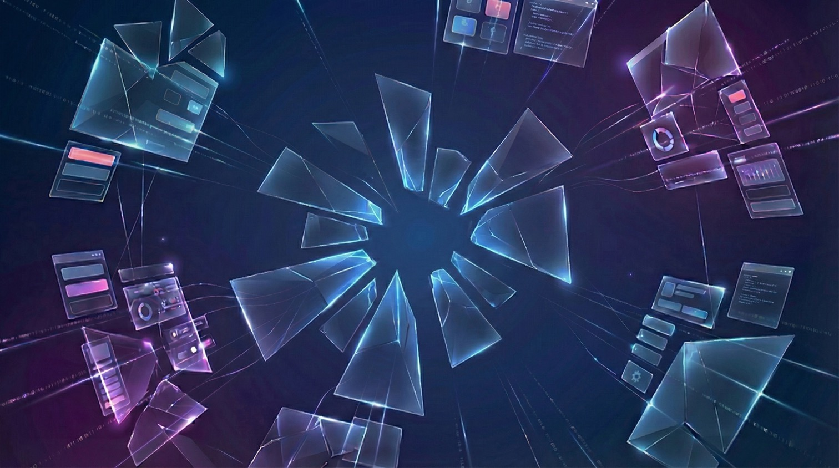

Reaching users
with MCP Apps
Ido Salomon
AI Disclosures Convening, 2026

Slide 2
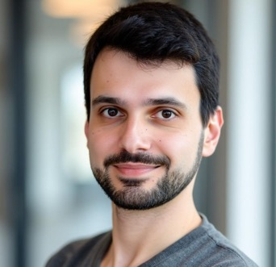



Ido Salomon
Creator @ MCP-UI
Co-creator & Maintainer @ MCP Apps
Creator @ AgentCraft
@idosal1
idosal
ido-salomon

Slide 3



Our focus so far
Publisher
Model
User
Gets a citation
(maybe)
Owns the
customer
Sees the brand
in fine print (maybe)

Slide 4
What if every app in the world could send its own UI to any host?
Notes:
How do we transition from walls of text
To rich interactive GUI

Slide 5
  Enter MCP Apps
Notes:
That’s why we created MCP Apps

Slide 6
Interactive apps over MCP
Standardizing UI transmission
And
UI<>Host communication

Slide 7
  Apps interact with users directly
Notes:
That’s why we created MCP Apps

Slide 8
  Clients gain capabilities, trust, and telemetry
Notes:
That’s why we created MCP Apps

Slide 9
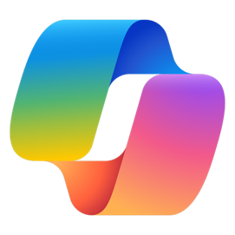
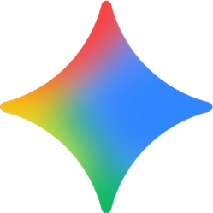



MCP Apps are everywhere
Notes:
Available in all major clients
Over 500 apps in ChatGPT alone
Walmart, Starbucks, Slack, Canva, and many others

Slide 10
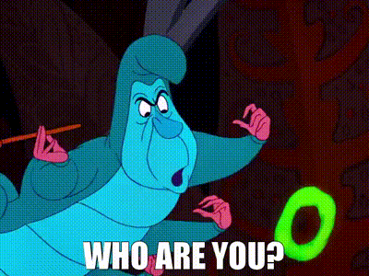
So why haven’t you heard of them?

Slide 11
  Discovery remains a huge gap
Notes:
That’s why we created MCP Apps

Slide 12
  Imagine a fair discovery mechanism built on existing web and MCP primitives
Notes:
That’s why we created MCP Apps

Slide 13
  Demo time!
Notes:
That’s why we created MCP Apps

Slide 14
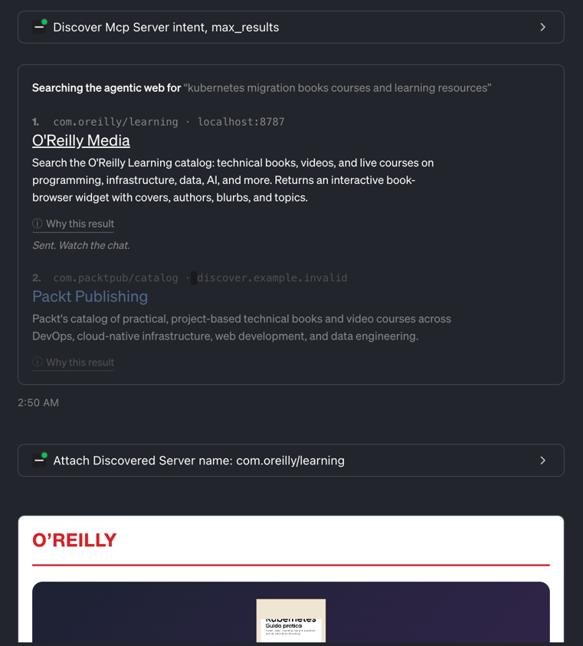
Notes:
That’s why we created MCP Apps

Slide 15
Embrace the new web.
Notes:
I hope these 20 minutes got you excited
We have the greatest opportunity to build the new web
Go back to the core user experience of your apps, think of what you can achieve
Not with a single app, but a web of apps connected by a model

Slide 16
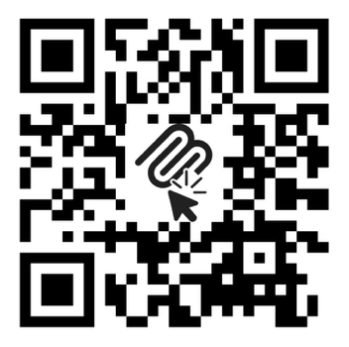
Thank You!
@idosal1
idosal
ido-salomon
Notes:
Focus on the core user experience
Open your mind to the fragmented web
Go build UI-enabled MCP servers and hosts!

